Slide 1

Optimising Mental Health ED Wait Times in Australia Delivering Better Patient Care Through Predictive Analytics
Mini Project 3
Presented by: Nicole Perez
September 28, 2024

Slide 2

Introduction
Emergency departments (EDs) in Australia face significant challenges in managing wait times, particularly for mental health patients.
Long wait times can lead to increased patient distress, poor health outcomes, and inefficiencies in hospital operations. Addressing this issue is critical for improving patient care and operational efficiency.

Slide 3
Business Problem:
Challenges:
Resource Allocation: Inefficient allocation of staff and resources leading to bottlenecks and prolonged wait times.
Operational Inefficiencies: Lack of real-time data and predictive insights to optimise scheduling and resource management.
Patient Satisfaction: Long wait times negatively impacting patient satisfaction and health outcomes.
Goals:
Improve Patient Flow: Streamline processes to reduce wait times and improve patient throughput.
Enhance Resource Management: Optimise the allocation of staff and resources based on predictive insights.
Increase Patient Satisfaction: Provide timely care to improve patient experiences and health outcomes.

Slide 4


Data Science Problem: Developing a Predictive Model to Optimise Mental Health ED Wait Times
Dataset source: Mental health Presentations to Emergency Departments
https://www.aihw.gov.au/mental-health/topic-areas/emergency-departments#characteristics

Slide 5
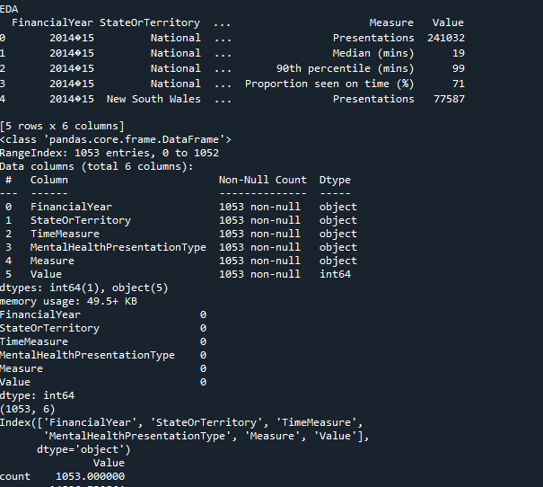
Data Collection and Preparation | EDA
Dataset Structure:
The dataset contains information on emergency department (ED) wait times and length of stay across various states and territories in Australia.
Key Columns:
Financial Year
State Or Territory
Time Measure
Mental Health Presentation Type
Measure
Value

Slide 6
Data Collection and Preparation | EDA
Summary Statistics
Measures: The dataset includes various measures such as the number of presentations, median wait times, 90th percentile wait times, and the proportion of patients seen on time.
Central Tendency and Dispersion: Summary statistics provide insights into the central tendency (mean, median) and dispersion (standard deviation, percentiles) of these measures.
Missing Values
Completeness: There are no missing values in the dataset, ensuring the completeness and reliability of the data.

Slide 7
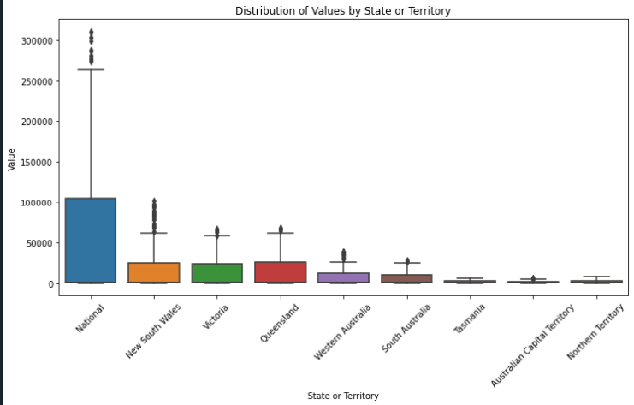
Distribution of Values by State or Territory
Insights:
There is significant variability in the values (e.g., wait times, length of stay) across different states and territories.
Western Australia (WA) and South Australia (SA) show higher median values and greater variability, indicating longer wait times and length of stay in these regions.
New South Wales (NSW) and Victoria (VIC) have relatively lower median values, suggesting more efficient emergency department services.

Slide 8
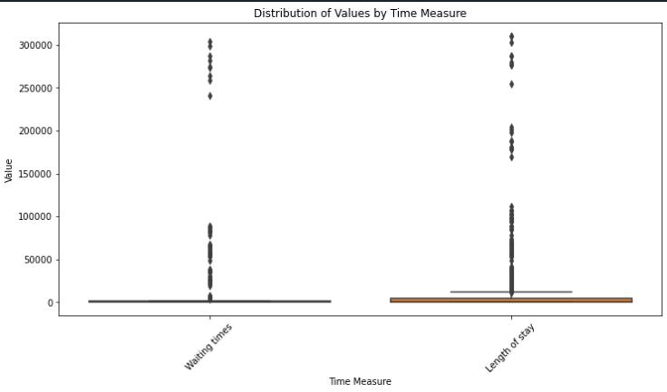
Distribution of Values by State or Territory
Insights:
The median wait times and 90th percentile wait times show a wide range, indicating variability in how quickly patients are seen in emergency departments.
The proportion seen on time varies significantly, with some regions achieving higher compliance with target wait times.
The length of stay for presentations ending in admission is generally higher than for those not ending in admission, reflecting the additional time required for admitted patients.
These insights can help in benchmarking performance and setting realistic targets for emergency department operations.

Slide 9
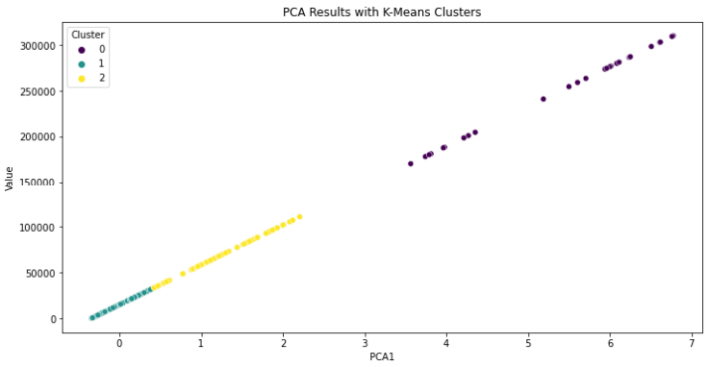
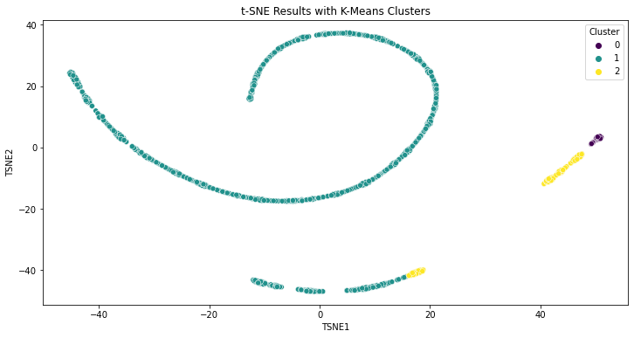
Unsupervised Learning: Clustering
Summary of Findings
Cluster 2: Regions with moderate wait times and length of stay. These regions may benefit from targeted improvements to reduce wait times further.
Cluster 0: Regions with the highest wait times and length of stay. These regions require immediate attention and resource allocation to improve efficiency.
Cluster 1: Regions with the lowest wait times and length of stay. These regions can serve as benchmarks for best practices.

Slide 10
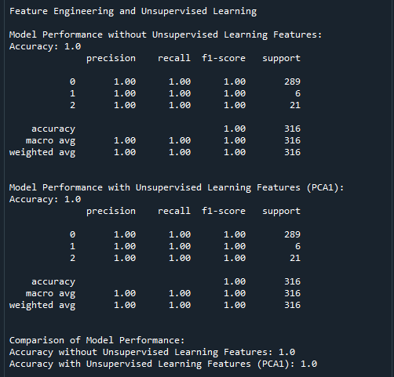
Feature Engineering Comparison of Model with and without Unsupervised Learning Features
Data Characteristics:
- Simplicity of the Data
- Redundancy of PCA Feature
Cluster Distribution:
-Imbalanced Clusters
Model Robustness:
-Random Forest Strength
- Overfitting
Notes:
Both models (with and without unsupervised learning features) achieved perfect accuracy, indicating that the original feature (Value) was sufficiently informative for predicting ED wait times.
The inclusion of PCA-derived features did not significantly impact the model’s performance, suggesting that the dataset was relatively simple or that the clusters were easily distinguishable based on the Value feature alone.
Random Forest Strength: Random Forest is a robust model that can effectively handle the given data even without additional features. Its ensemble nature allows it to capture complex patterns and interactions within the data.
Overfitting: The perfect accuracy (1.0) on both models might indicate potential overfitting, especially if the dataset is small or not very complex. This means the model might be performing exceptionally well on the training and test data but may not generalize as well to new, unseen data.

Slide 11
Recommendations for Future Improvements
Increase Dataset Size:
Collect more data points to ensure the dataset is representative of various scenarios and patient demographics.
Enhance Data Quality:
Ensure data completeness and regularly clean the data to remove inconsistencies and errors.
Include Additional Features:
Add patient demographics, temporal features, and hospital capacity data to provide more context for predictions.
Balance the Dataset:
Use techniques like oversampling or undersampling to address class imbalance and ensure fair model evaluation.
Regular Updates:
Continuously collect new data and periodically retrain the model to maintain accuracy and relevance.
Data Integration:
Integrate external data sources, such as weather conditions or public health data, to provide additional context for predictions.
Collaborate with Domain Experts:
Work with healthcare professionals to identify relevant features and validate the data.

Slide 12
Business value
Resource Allocation:
Accurate predictions help allocate resources effectively, ensuring adequate staffing and equipment in high-demand areas.
Operational Efficiency:
Optimised scheduling and reduced bottlenecks lead to more efficient operations.
Improved Patient Care:
Reduced wait times enhance patient satisfaction and outcomes.

Slide 13


Predictive analytics, particularly using robust models like Random Forest, can significantly optimise ED wait times in mental health settings. By leveraging data insights, healthcare administrators can make informed decisions to allocate resources efficiently, improve operational workflows, and ultimately deliver better patient care. Continuous improvement of the dataset and model, along with collaboration with domain experts, will ensure sustained success in optimizing ED wait times. By implementing these strategies, Australia can enhance the quality of mental health services, ensuring timely and effective care for patients in need.
Conclusion

